Slide 1
Capstone Project IPL T20 Cricket Analysis
by Nikhil TN Sandeep Kumar Prathmesh Nerle Suryauday Vishwakarma

Slide 2
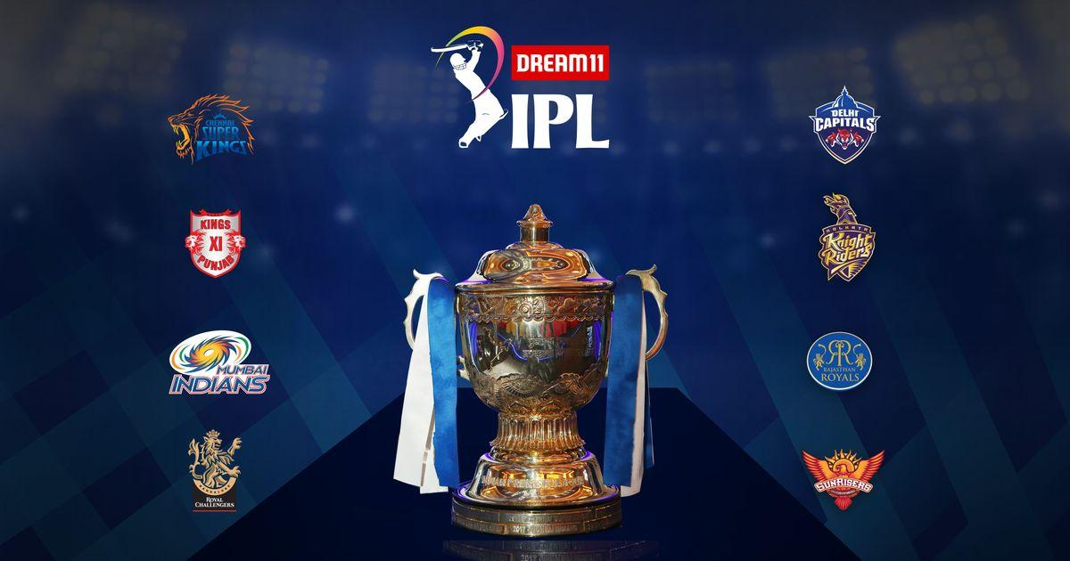
IPL-Indian Premier League
It is one of the biggest Cricket League in the World, where all the Cricketer’s from different part of the world participate in this Tournament.
This tournament is scheduled once in a year in the month of April/May. For all the cricket fans in India ,it is be like a festival.

Slide 3
Data Summary
Matches Dataset : This dataset consists information abount the Venues, Players, Umpires, Toss decisions in 696 matches of IPL from 2008-2019.
Delivery Dataset: This dataset consists ball by ball information about 696 matches of IPL from 2008-2019
Teams Dataset: This data set consists the information of each team from 2008-2019

Slide 4
Discussion
Toss decision made in IPL season.
Match won by winning the toss opted for field or bat
Best Bowlers in terms of wickets.
Best Bowling team in terms of economy
Highest sum of score by teams in each season
Is scoring over the years is easy
Most number of Man of the Matches in each season.
Highest winning margin in terms of runs and wickets in each year.

Slide 5
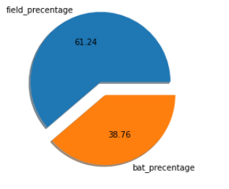
Percentage of Toss decision made in IPL session

Slide 6
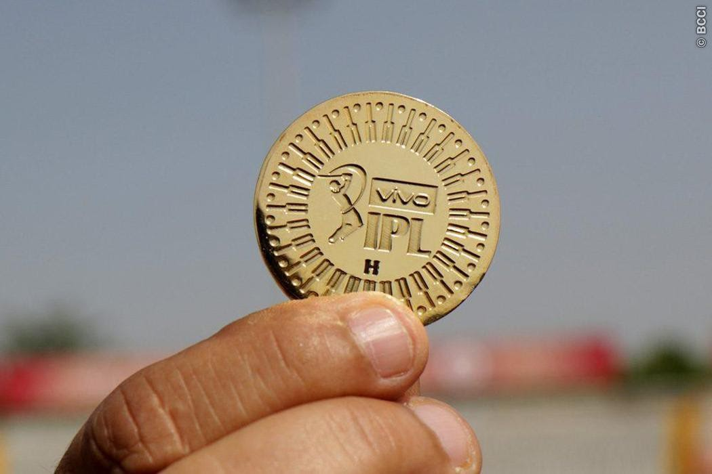
Observation
From the above EDA, we observed that winning toss percentage choosed to bat or field for all the IPL session from 2008 - 2019.
The team Won toss and choosed for field is 61.24%
The team won toss and choosed for batting is 38.76%
The teams are winning the toss and choosed for fielding are mostly.

Slide 7
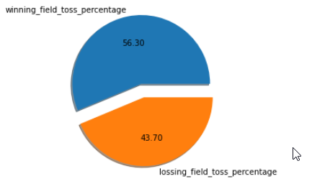
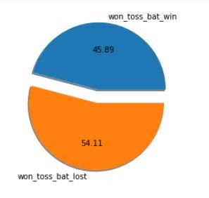
Match won by Winning the toss elected to field or Bat

Slide 8

Observation:
756 matches had been played between 2008 – 2019.
We have observed that when team won the toss and opt for field they have 56.30% winning percentage.
When team had won the toss and elected to bat first have won the matches by 45.89%.

Slide 9
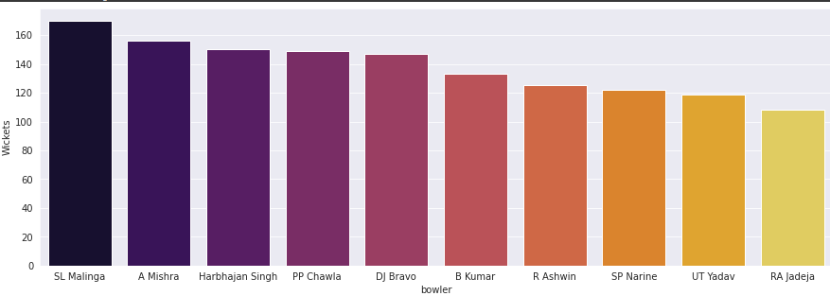
Best Wicket Takers In IPL(2008-2020)

Slide 10
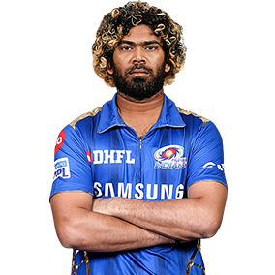
Best Bowler
Name | Lasith Malinga
Age | 37
Nationality | Sri-Lanka
IPL Team | Mumbai Indians
Total Wickets | 170
Lasith Malinga has taken 170 wicket in his IPL career which makes him best wicket tacking bowler in IPL.
Malinga is followed by Indian bowler Amit Mishra with 155 total wickets.
Harbhajan Singh has took 150 wickets in IPL, Also he is close competitor to Amit Mishra.
LASITH MALINGA

Slide 11
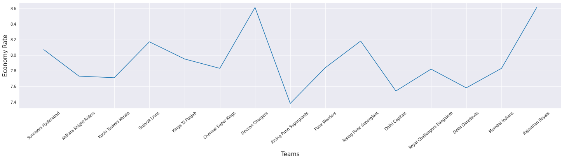
Economy Rate of Each Team

Slide 12

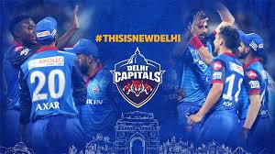
T-20 Cricket is often considered as Batsman’s Game, but these two teams have changed the Entire Picture.
Rising Pune Supergiants have the best bowling attack although they have maintained lowest Economy rate in IPL.
Rising Pune Supergiants is followed by Delhi Capitals with Economy Rate of 7.53.
By Comparing the graph, we can conclude that Rajasthan Royals and Deccan Chargers have weakest bowling attack.

Slide 13
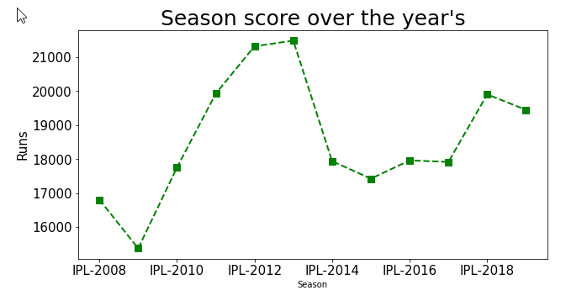
Is scoring runs in seasons is easy over the years?
It is been observe that there has been drastic fall in runs between IPL season 2013 & 2014.
The reason for these is in IPL season 2013 total no. of matches played were ‘76’ while in season IPL-2014 total no. of matches played were ‘60’.
Reason for reduction in no. of matches played is in IPL-2014 one teams was dropped and only 8 teams were playing as compared to previous season which had 9 teams.
Team withdrawn was ‘Pune Warriors India’

Slide 14
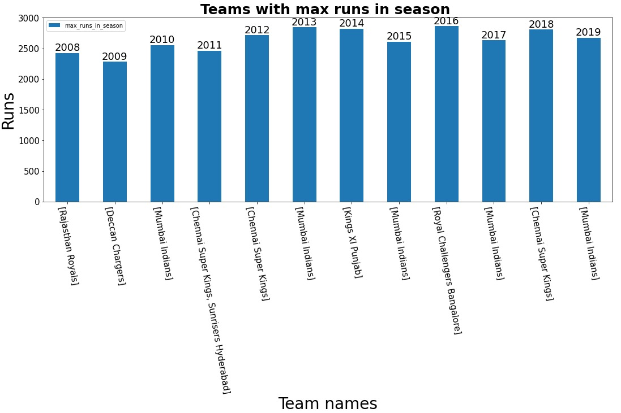

Highest score by teams in each season
The highest total runs scored by the team from IPL 2008 - 2019.
We can also see that the team repeating, which has score max run in each season.
‘Mumbai Indian’ is a team who have score ‘5-times’ max runs in all seasons.

Slide 15
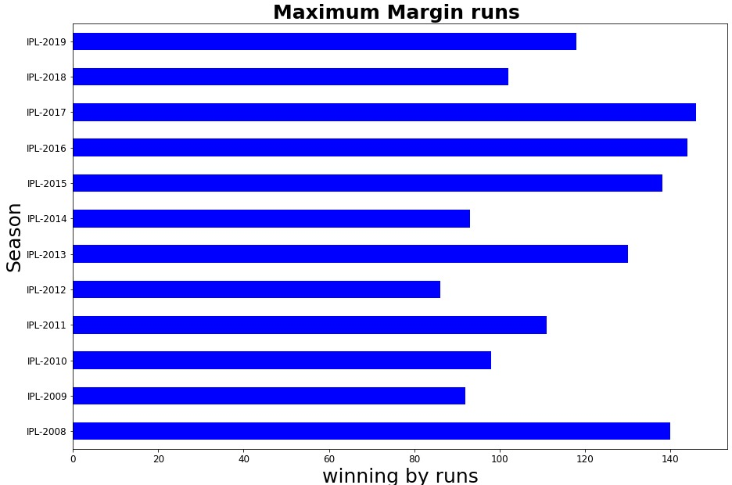
Winning Margin in terms of runs

Slide 16
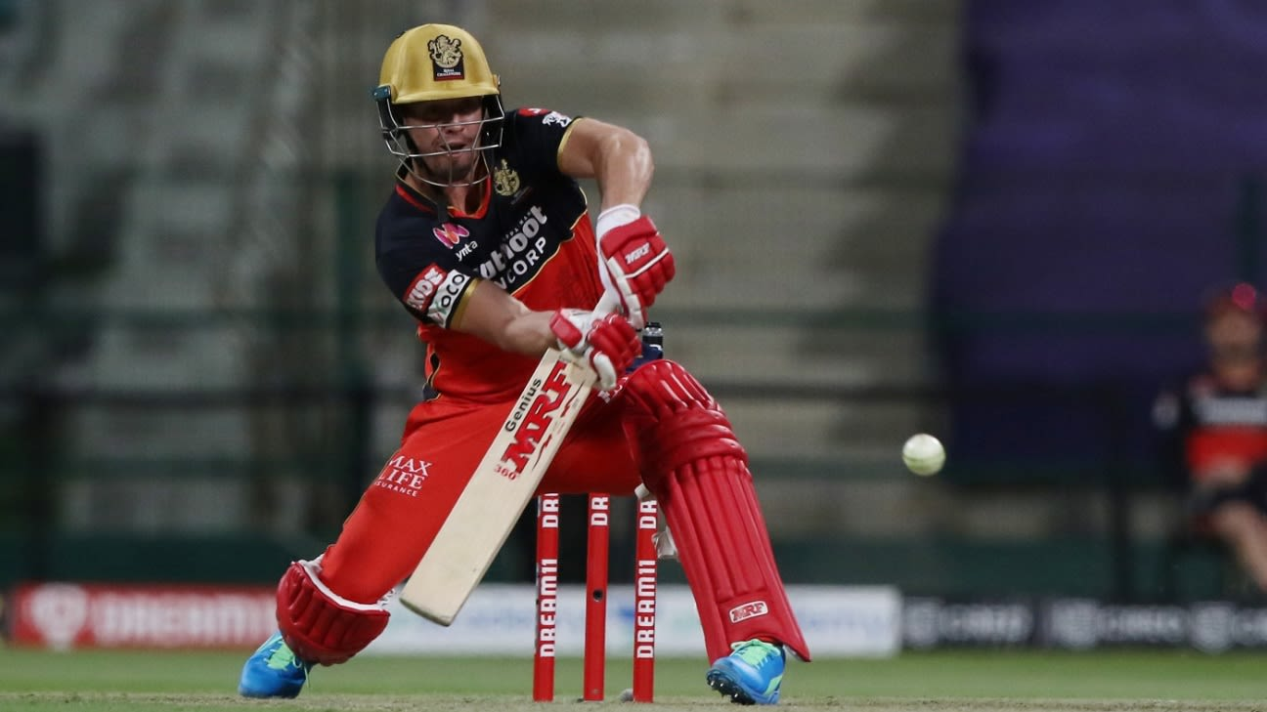
Observation
We observed that in each season of IPL, winning margin in terms of runs vary.
We observed that 146 is the highest winning and 86 is lowest winning margin as compared to other seasons.
We also observed that Mean value of this winning margin runs is 116.5.
From this analysis we can conclude that in upcoming seasons highest margin win in terms of runs will be in the range between 86-146 runs.

Slide 17
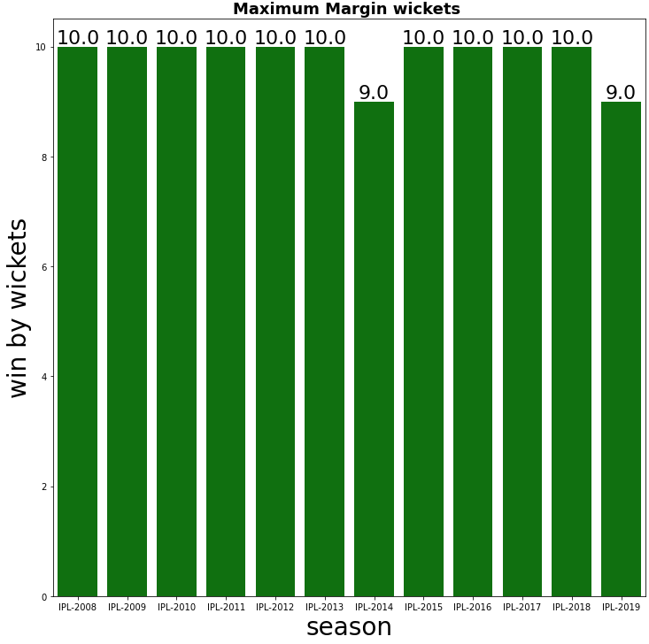
Winning margin in terms of wickets

Slide 18
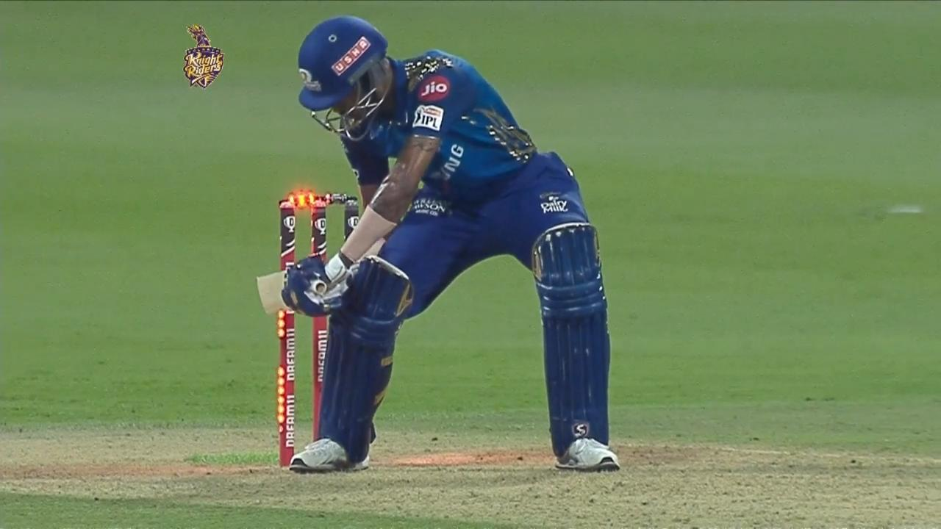
Observation
we observed that in each season of IPL, Highest winning margin in terms of wickets is almost equals to 10.
We observed that maximum winning margin in terms of wickets is 10 for almost all the seasons.
We also observed that mean value of this margin wickets is 9.83 almost equal to 10.
From this analysis we can conclude that in upcoming seasons highest margin win in terms of wickets will be in the range between 9-10 wickets.

Slide 19
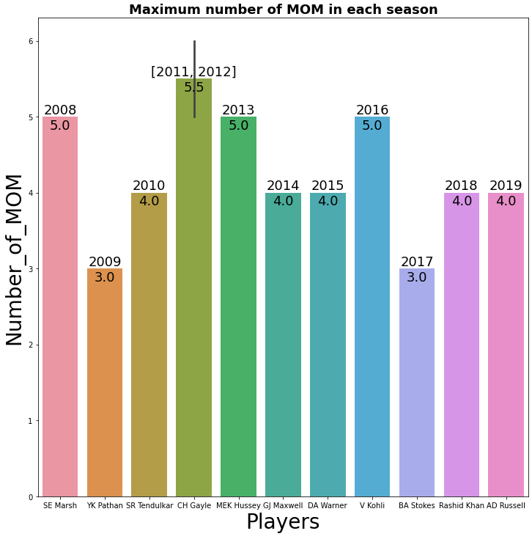
Maximum number of Man of the Match in each Season

Slide 20
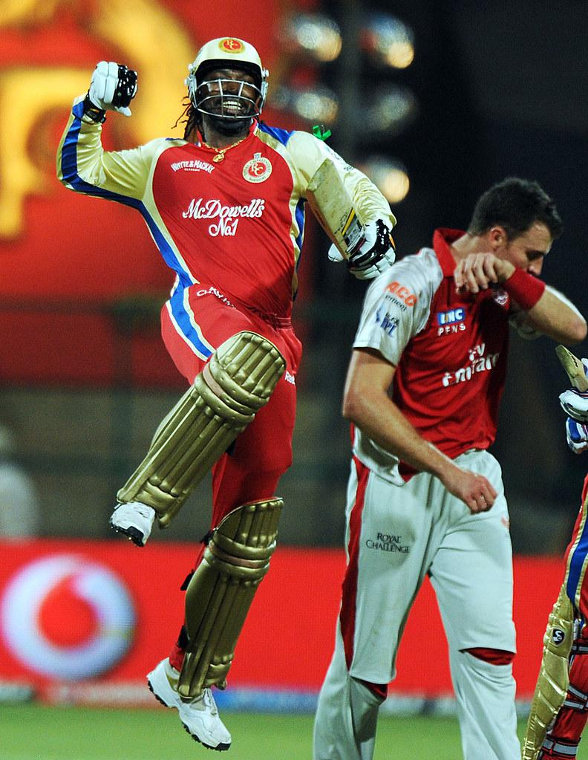
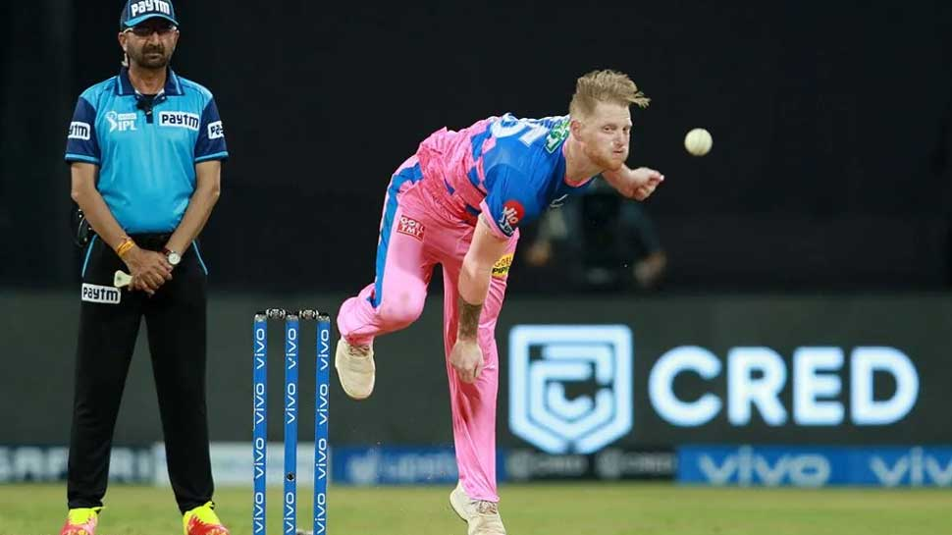
Observation
We observed that in each season of IPL, Max number of Man of the match won by a single player at the end of the each season varies.
In IPL-2011 and IPL-2012 CH Gayle has won maximum number of Man of Match award as compared to other players.
From this analysis we can conclude that a single player had won maximum 6 man of the match award.
We also observed that mean value of this MOM is 4.3.

Slide 21
Conclusion
Maximum times when team won the toss, they opt for field first.
Team who won the toss and opted for batting have lost a greater number of matches.
Scoring runs in IPL after season IPL-2013 is been difficult.
Mumbai Indian is a team who has scored the maximum time highest runs in all seasons.
Lasith Malinga is best bowler in IPL.
Rising Pune Supergiants had the best bowling attack.
Chris Gayle has won maximum number of man of the match i.e 6 times in IPL 2011.
Highest winning margin in terms of runs is 146 runs and in terms of wickets its 10.

Slide 22
Thank you

